Slide 1
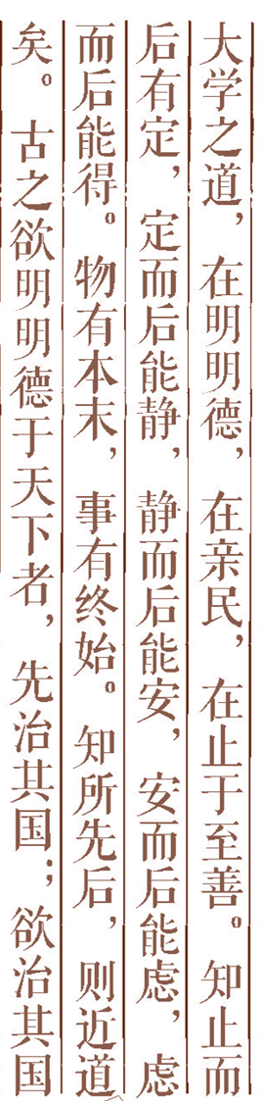
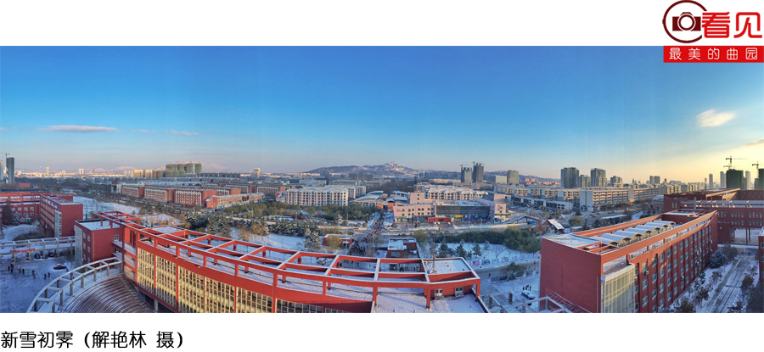

Artificial Intelligence Chapter 17. Knowledge-Based Systems {第17章 基于知识的系统}
Chapter 17 第2讲

Slide 2



Confronting the Real World [面对现实世界]
Reasoning Using Horn Clauses [用Horn子句进行推理]
Maintenance in Dynamic Knowledge Bases[动态知识库的维持]
Rule-Based Expert Systems [基于规则的专家系统]
Rule Learning [规则学习]
Additional Readings and Discussion [补充读物和讨论]
Outline

Slide 3
Forward Chaining（正向链）
A strategy for searching the rule base in an expert system that begins with the information entered by the user and
searches the rule base to arrive at a conclusion.
Reasoning proceeds forward, beginning with facts, chaining through rules, and finally establishing the goal.
A rule is applicable if each of the literals in its antecedent can be unified with a corresponding fact.
When more than one rule is applicable, some sort of external conflict resolution scheme is used to decide which rule will be applied.

Slide 4
Backward chaining
A strategy for searching the rule base
in an expert system that acts like a
problem solver by beginning with a
hypothesis and seeking out more
information until the hypothesis is
either proved or disproved.

Slide 5
17.3 Maintenance in Dynamic Knowledge Bases
Knowledge base of propositional calculus atoms
The atoms are called premisses(前提) instead of facts.
The rules are not restricted to being Horn rules.
A spreadline(扩展行) reasoning system
Any cell that has a formula in it gets its value immediately calculated from the values of components.
If the values of any components of a formula happen to change, the value of that formula is automatically changed.

Slide 6
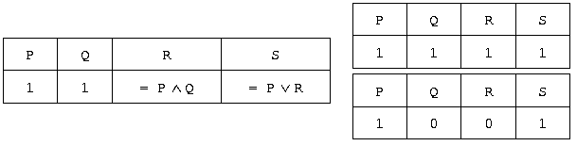

Slide 7
Truth maintenance systems (TMSs)
Dynamic knowledge base: the spreadline is extended to contain any number of premises and rules.Such a structrue can be thought of as a kind of dynamic knowledge base.
The formulas entered in the values of rule cells are called justifications（理由）.
The values of certain premises cells can be omitted.
When a cell has a value of 1 or 0, it is called IN; otherwise, out.
Allowing values of cells to be OUT permits an interesting generalization of rule types (e.g, U if R is True and S is Out).

Slide 8
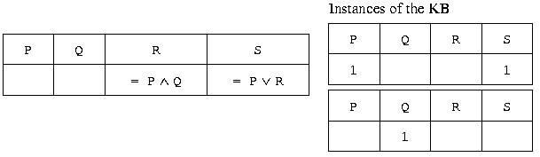

Slide 9
TMSs should be thought of as knowledge base maintenance systems that perform automatic updates when the truth values of certain atoms are changed.
The use of IN’s and OUT’s permits an elementary sort of “monotonic” or defeasible inference not sanctioned by ordinary reasoning systems.
Cycles among the rules present some difficulties.E.G. P, P→Q, Q→R, R→Q.
One is mutual justification（互为证明）.

Slide 10
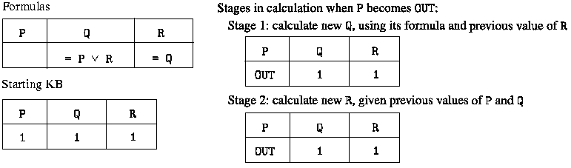

Slide 11
Assumption-based truth maintenance systems (ATMSs)[基于假设的真值维护系统]
The spreadline is used in a backward direction.
We start with a particular cell’s formula and ask which premises values will make the formula in that cell True.
Other formulas called the background theory（后台理论） are considered together.
Labels of the cells
The values of the cells are taken to be formulas-expressed in DNF form in terms of the premises atoms.
ATMSs can be used for a variety of purposes.
One is to perform diagnosis.

Slide 12
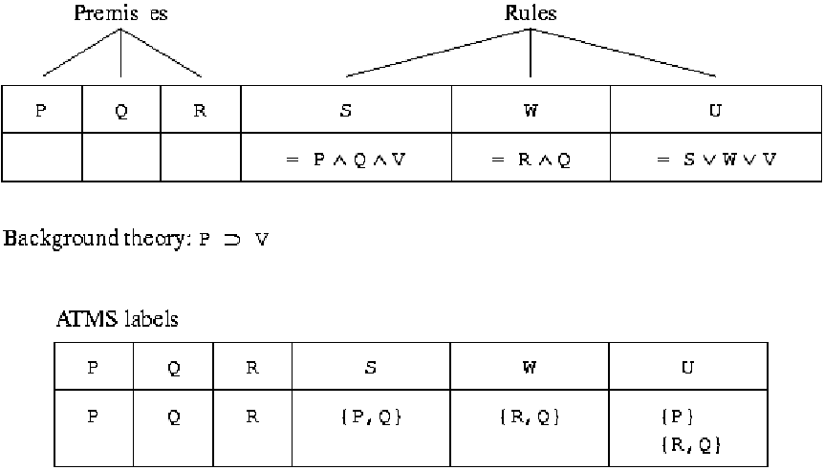

Slide 13
Rule-Based Expert Systems [基于规则的专家系统]
1、What is an expert system (ES)? Expert System: Knowledge intensive computer program that captures the expertise of a human in limited domains of knowledge.

Slide 14
Expert systems provide expert quality advice, diagnoses and recommendations on real world problems.
ES performs a task in limited domains that require human expertise.
e.g.medical diagnosis; fault diagnosis; status monitoring; data interpretation; mineral exploration; credit checking; tutoring; computer configuration.

Slide 15
Examples:
Medical diagnosis - program takes place of a doctor; given a set of symptoms the system suggests a diagnosis and treatment
Car fault diagnosis - given car's symptoms, suggest what is wrong with it.

Slide 16
Domain knowledge is acquired by interviewing human experts.
ES solves problems by application of domain
specific knowledge rather than weak methods.
ES can explain a problem solution in human-understandable terms
ES cannot operate in situations that call for common sense

Slide 17
2、what is Rule-based expert system?
Rule-based expert system: An AI program that has a large number of interconnected and nested IF-THEN statements, or rules, that are the basis for the knowledge in the system.

Slide 18
3、Examples of Expert Systems
1965 DENDRAL Stanford analyze mass spectrometry data
1965 MACSYMA MIT symbolic mathematics problems
1972 MYCIN Stanford diagnosis of blood diseases
1972 Prospector SRI Mineral Exploration
1975 Cadeceus U. of PITT Internal Medicine
1978 DIGITALIS MIT digitalis therapy advise
1979 PUFF Stanford obstructive airway diseases
1980 R1 CMU computer configuration
1982 XCON DEC computer configuration
1983 KNOBS MITRE mission planning
1983 ACE AT&T diagnosis faults in telephone cables
1984 FAITH JPL spacecraft diagnosis
1986 ACES Aerospace satellite anomaly diagnosis
1986 Cambpell diagnose cooker malfunctions
1986 DELTA/CATS GE diagnosis of diesel locomotives
1987 AMEX credit authorization
1992 MAX NYNEX telephone network troubleshooting
1995 Caltech PacBell network management
1997 UCI planning drug treatment for HIV

Slide 19
4、Structure of Expert System
User
Expert/s
Knowledge engineer
Human-computer interface
Knowledge
acquisition
subsystem
Explanation
subsystem
Knowledge
base
Inference
engine

Slide 20
Knowledge base: Model of human knowledge that is used by expert systems.
Rule base: The collection of knowledge in an AI system that is represented in the form of IF-THEN rules.
Inference engine: The strategy used to search through the rule base in an expert system; can be forward or backward chaining.
Knowledge Engineer: A specialist who elicits information and expertise from other professionals and translates these knowledge into a set of rules or frames for an expert system.

Slide 21
E.G 1:Expert system for Headache （感冒专家系统）
Headache

Slide 22
Rule base
If ‘病位’=‘头部’and ‘流鼻涕’and ‘头晕’
Then ‘病’=‘感冒刚起’
If ‘病位’=‘头部’and ‘鼻塞’and ‘浑身无力’, Then ‘病’=‘感冒’
If ‘病位’=‘头部’and ‘发烧’and ‘头晕’and ‘扁桃体肿’, Then ‘病’=‘严重感冒’

Slide 23
/*----------------- 感冒 处方----------------*/
If ‘病位’=‘头部’and ‘感冒刚起’
Then ‘处方’=‘服用速效伤风胶囊，日服三次，每次一颗。’
If ‘病位’=‘头部’and ‘一般感冒’
Then ‘处方’=‘服用感冒通，日服三次，每次三颗。’
If ‘病位’=‘头部’and ‘严重感冒’
Then ‘处方’=‘注射青霉素，日注射两次，每次80万单位。’

Slide 24
1. Forward reason
服用感冒通，日服三次，每次三颗
头部、鼻塞、浑身无力
Human-computer interface
DB
头部、鼻塞、浑身无力 一般
感冒服用感冒通，日服三次，每
次三颗
KB
If ‘病位’=‘头部’and ‘鼻塞’and ‘浑身无力’
Then ‘病’=‘感冒’
If ‘病位’=‘头部’and ‘一般感冒’
Then ‘处方’=‘服用感冒通，日服三次，每次三颗。’
Inference
engine

Slide 25
2. Explanation subsystem
HOW？(你是如何得出结论的）
您说“头部”、“鼻塞”、“浑身无力”，由规则A，您是“ 一般感冒”；又由规则B您需服用感冒通。
Interface
头部、鼻塞、浑身无力 一般
感冒, 服用感冒通，日服三次，
每次三颗
解释模块
A. If ‘病位’=‘头部’and ‘鼻塞’and ‘浑身无力’
Then ‘病’=‘感冒’
B. If ‘病位’=‘头部’and ‘一般感冒’
Then ‘处方’=‘服用感冒通，日服三次，每次三颗。’

Slide 26
5、Where do the rules come from ?
Manual Knowledge Acquisition
Automated Knowledge Acquisition

Slide 27
Manual Knowledge Acquisition
interview experts
expert describes the rules
process of translating expert knowledge into a formal representation is also known as knowledge engineering
this is notoriously difficult
experts are often very poor at explicitly describing what they do
e.g., ask Michael Jordan how he plays basketball or ask Tiger Woods how he plays golf

Slide 28
Automated Knowledge Acquisition
derive rules automatically from formal specifications
e.g., by automatic analysis of solution manuals
machine learning
learn rules from data

Slide 29
CLASS IS OVER!

